Slide 1

Spirit of two islands
Terra Sicula - Terra Australis
Maria Sanciolo-Bell
President
Institute of Culture Sicily Australia (I.C.S.A.)
Athenaeum Club
La Tavola Italiana
18th July 2018
Notes:
THANK YOU:
PEOPLE PRESENT
BILLY DOOLAN
HANS SIP
SPECIAL THANK YOU TO MIKE FINNEY and his committee FOR THEIR INVITATION TO ME TO SPEAK TO YOU TODAY
I WOULD ALSO LIKE TO ACKNOWLEDGE THE Traditional Owners of the land on which we are meeting. I pay my respects to their Elders, past and present.

Slide 2
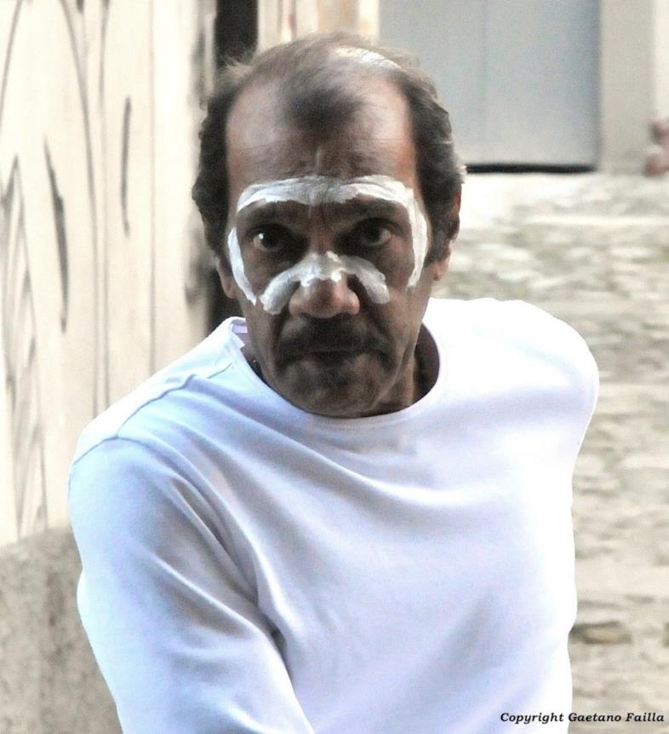
L’artista Aborigeno che dipinse la Sicilia
Notes:
TODAY I WOULD LIKE TO SHARE WITH YOU THE BACKGROUND OF THIS IMPORTANT PROJECT AND THE JOURNEY UNDERTAKEN BY BILLY DOOLAN TO SICILY AS WELL AS THE STUNNING PAINTINGS THAT FOR THE FIRST TIME EVER DEPICTED ELEMENTS OF SICILY, ITS LANDSCAPE, ITS CULTURE, ITS NATURE THROUGH THE EYES OF AN INDIGENOUS AUSTRALIAN ARTIST.
IN ADDITIONAL TO THEIR AESTETHIC VALUE, THESE PAINTINGS ARE IMPORTANT BECAUSE THEIR REPRESENT A NEW ART GENRE IN WHICH INDIGENOUS ICONOGRAPHY IS APPLIED TO SUBJECTS THAT ARE NOT RELATED TO “COUNTRY’ OR DREAMTIME.

Slide 3
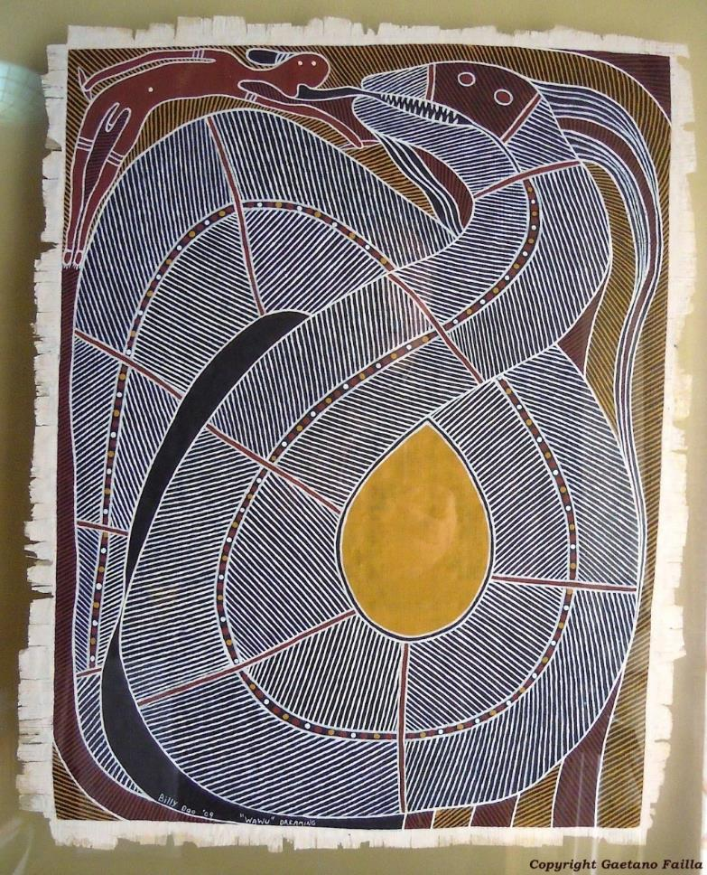
THE PROJECT
Notes:
The Project I have the pleasure of sharing with you today, was created to inaugurate the establishment of the Institute of Culture Sicily Australia – a not-for-profit Association whose aim is to promote cultural bridges between the land of Sicily and Australia.
The idea of exploring the way in which each of these lands is seen by people extraneous to it came about by chance, in a discussion amongst the Founding Members of the Association.
Over time it became apparent that it would be marvellous if we were able to communicate “the Spirit of Sicily” to Australian audiences in a way that would, in return, highlight to Sicilian audiences, the richness of the Australian Indigenous Culture.
The question was how to find an indigenous artist interested in our project !
It all began to take form through the intervention of Hans Sip – Indigenous Art Collector and Agent to a number of highly regarded indigenous artists (I recall calling him one day from Catania and his immediate interest and generous support, for which our institute is indeed grateful). In due course Hans presented to us Billy Doolan, as a possible person interested in taking this journey of discovery with us and so it was that after a number of meetings Billy decided to partake in the project and travel to Italy.

Slide 4
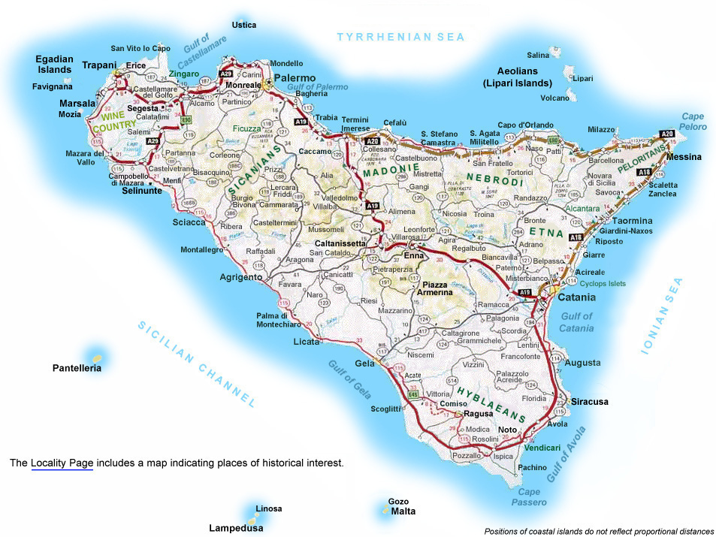
SICILY - ITINERARY
Notes:
SICILY CROSS ROADS OF CIVILIZATIONS
1/6th state of Victoria
5million people
AT LEAST 12 COLONIZATIONS
3 PARTS – Siculi/sicani/elimi
GREEKS/Carthagean/Phenicians

Slide 5
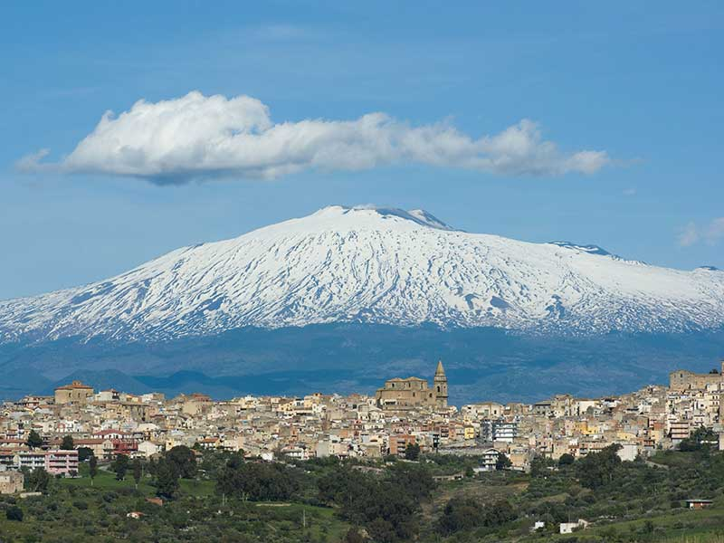
MT ETNA
Catania
Notes:
the most active stratovolcano in the world.
19,237 uninhabited hectares on the highest part of Mount Etna – classifies as UNESCO WHS
The eruptive history of the volcano can be traced back 500,000 years and at least 2,700 years of this activity has been documented.
MANY VILLAGES ON ITS SLOPES
HIGHT : 3 329.6 mt (10,924 feet)
CIRCUMFERENCE at its base 150km (93 miles)
WORLD HERITAGE SITE – 2013
Millennium Volcano
BILLY’s contribution
Etna from Regalbuto

Slide 6
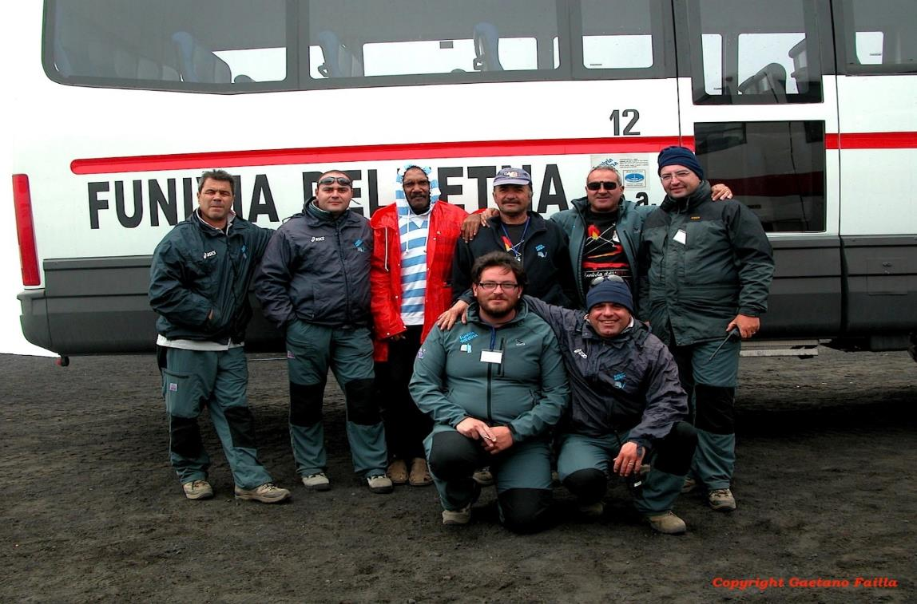
MT ETNA
Catania

Slide 7
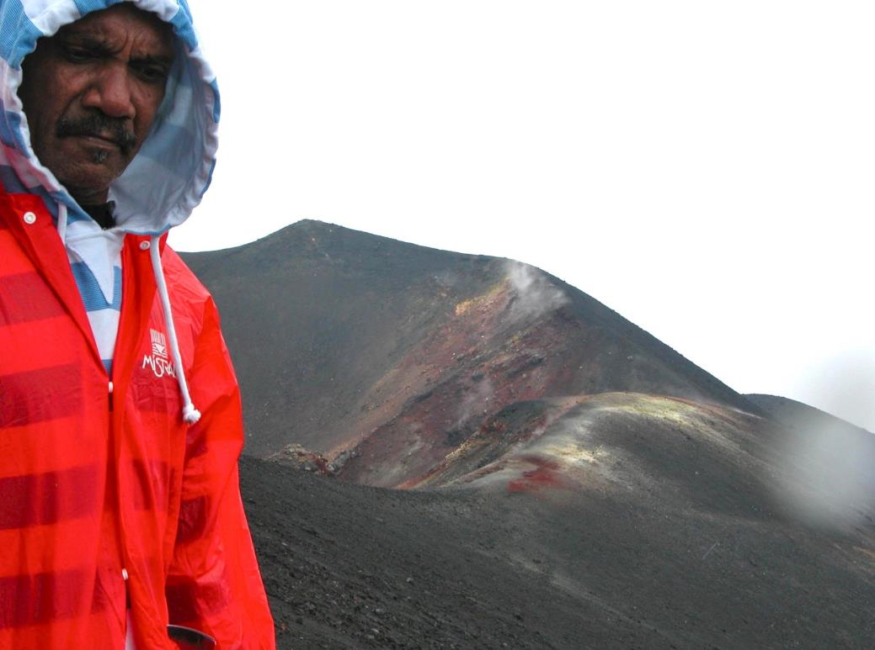
MT ETNA
Catania

Slide 8
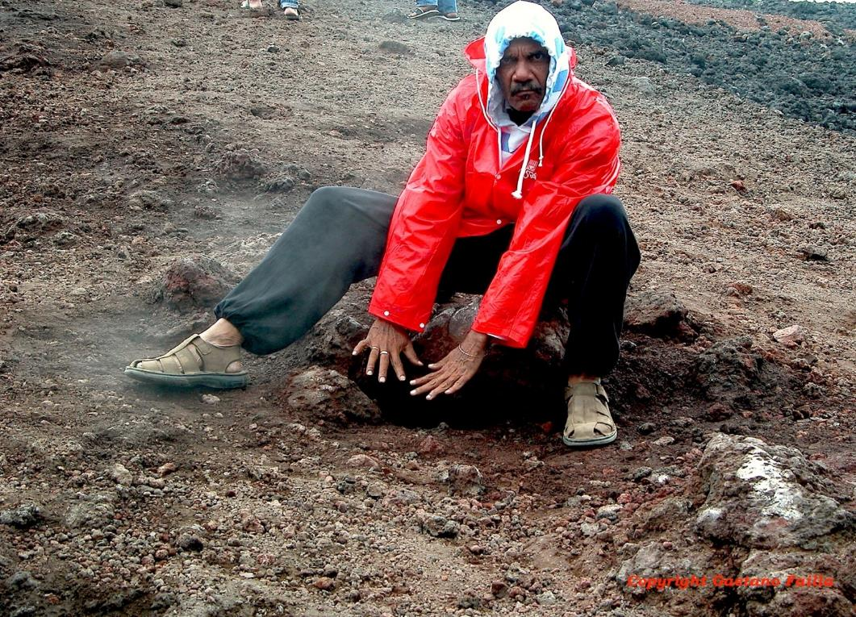
MT ETNA
Catania

Slide 9
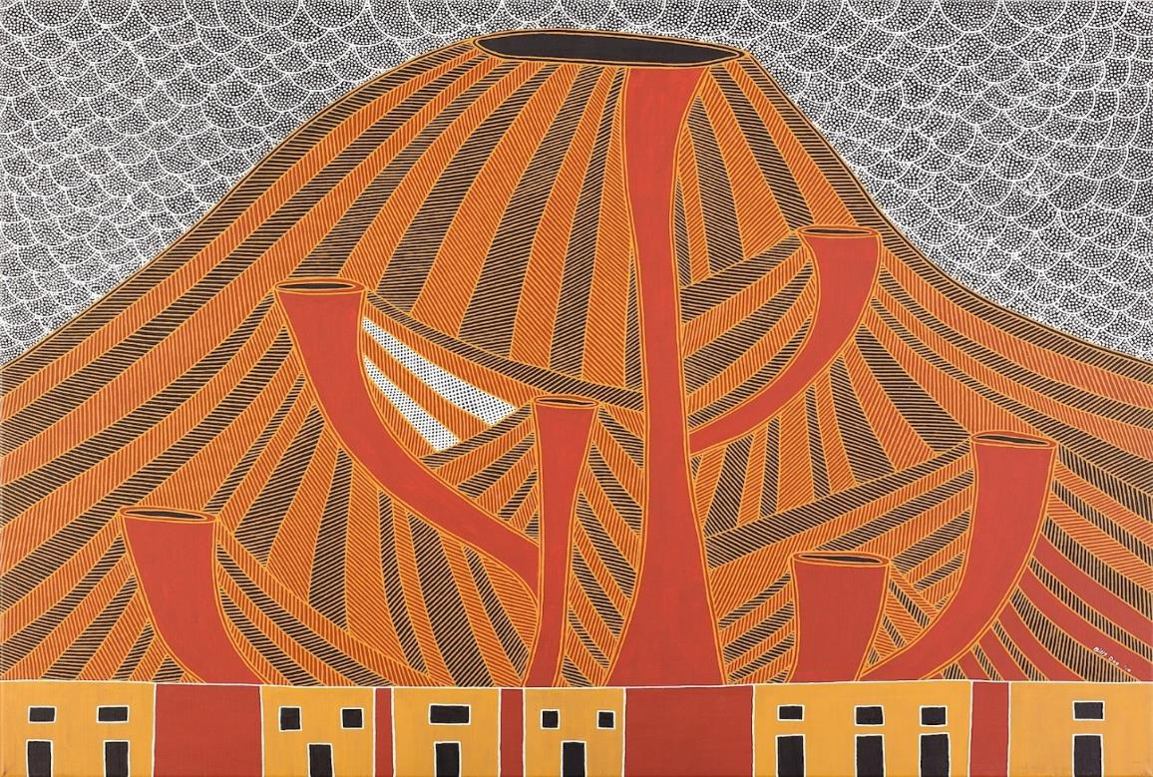
Etna Dreaming

Slide 10
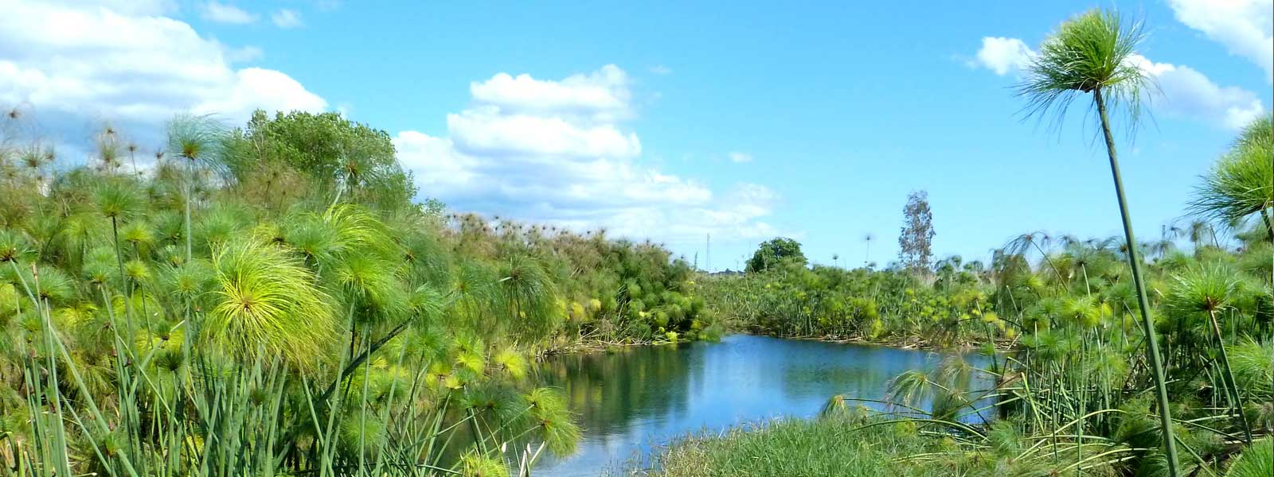
CIANE RIVER
Siracusa
Notes:
Pypirus in Sicily
According to the Istituto del Papiro, the papyrus was brought here from Egypt in 250 BC, a present from King Ptolemy to Hiero II, ruler of Syracuse, to thank him for their good commercial relationship. Hiero had established regular contacts with Alexandria, where a sizeable Syracusan community built up, employed in trade and in the arts and sciences. Archimedes studied mathematics in Alexandria in this period before returning to Syracuse to produce his major work.
The nymph Ciane, Persephone's childhood friend, was so overcome that she died of grief and her tears were turned into the spring on the spot where Persephone disappeared.
Top of pypirus called “parrucca” WIG

Slide 11
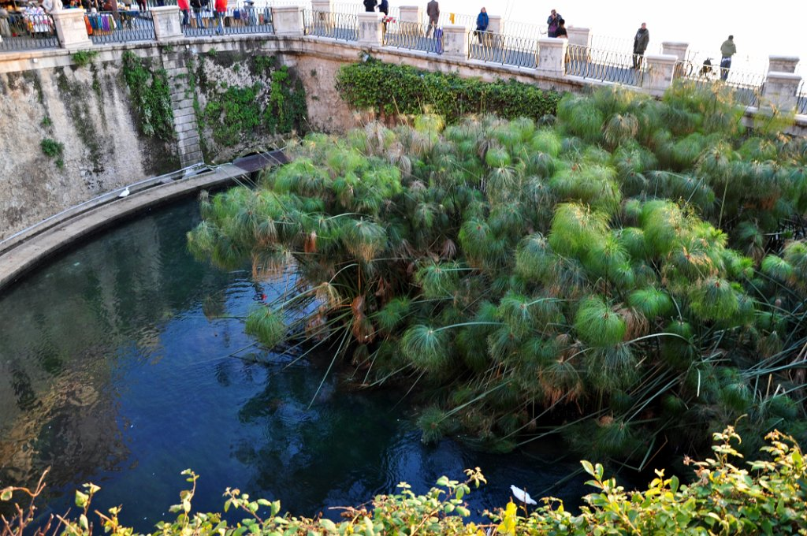
ARETHUSA FOUNTAIN
Ortigia
Notes:
INDIGENOUS VARIETY – LONG STEM up to 3 mt in hight

Slide 12
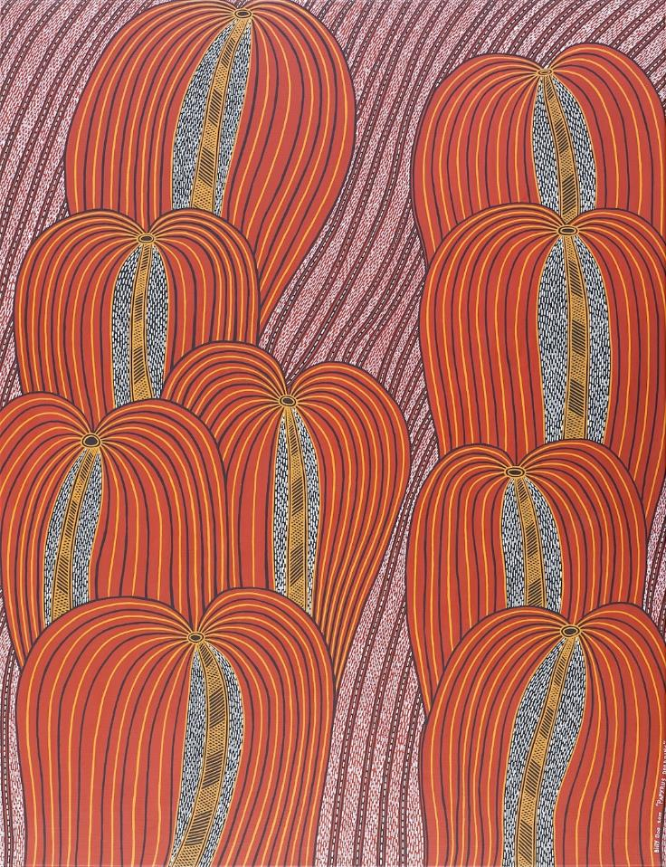
Papyrus
Dreaming

Slide 13
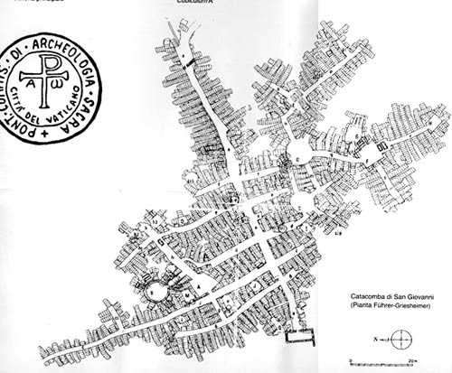
CATACOMBS OF SAN GIOVANNI
Siracusa
Notes:
built between the fourth and the sixth century AD, on the remains of an old Greek aqueduct. Their first documented use dates to later than the Edict of Constantine, which established freedom of worship of Christianity. At that time they were used as an early Christian cemetery.
The catacombs of St. John are, for size, the second largest in Italy after those of Rome. They were also used as air-raid shelter during the Second World War, which is why currently there are no bones to be found in the site.
The shape of the catacomb, running underground over 10,000 square meters, is similar to that of a castrum, which is the Roman military camp: in fact, the interior plant is composed of a “main street”, the “Decumanus Maximus” and ten secondary passages, the “Cardines” .
Related to the presence of the former aqueduct, the old water tanks were transformed in the Christian period into private funerary chapels reserved to the powerful, the clergy and the Roman patricians..
Within the catacombs we find three types of tombs: niche, arcosolium and formum. The niches were used as graves for babies or as ossuaries; the arcosolia were instead destined to famous people, to church or to the Roman patricians; the forma, however, were the typical tomb of the plebe.

Slide 14
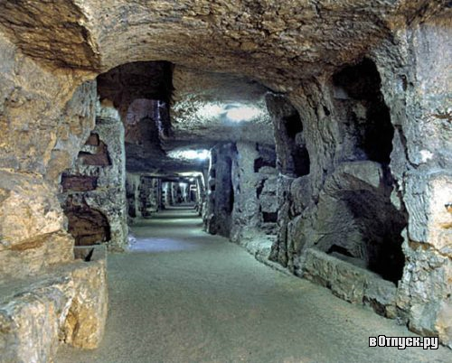
CATACOMBS OF SAN GIOVANNI
Siracusa

Slide 15
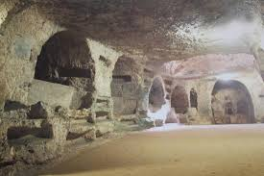
CATACOMBS OF SAN GIOVANNI
Siracusa

Slide 16
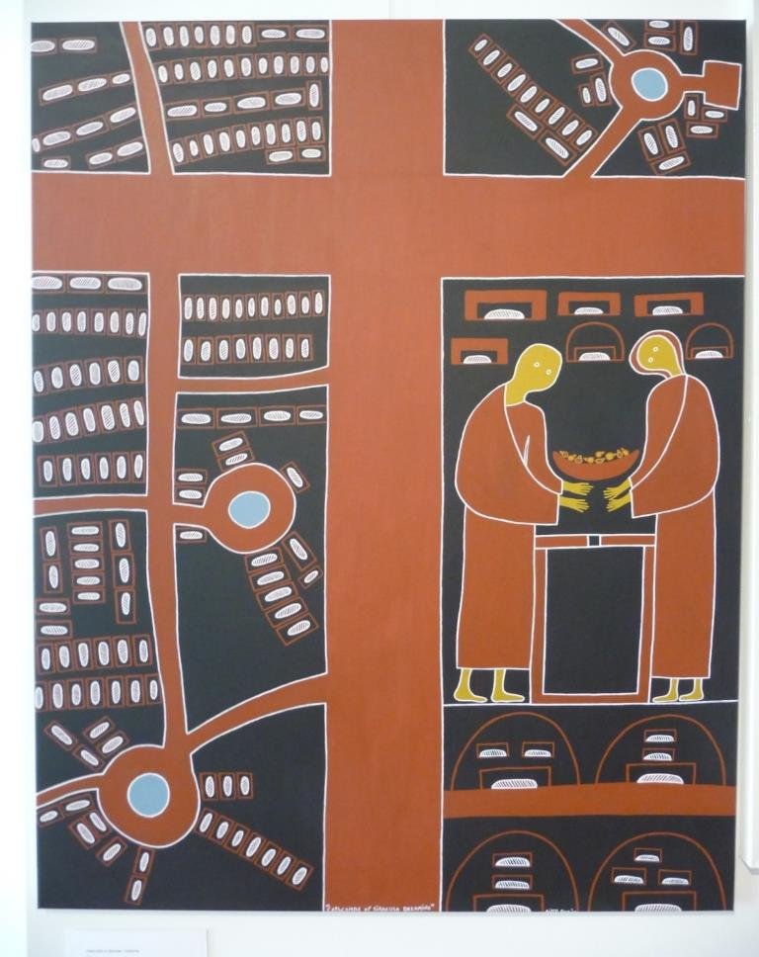
Catacombs
Dreaming

Slide 17
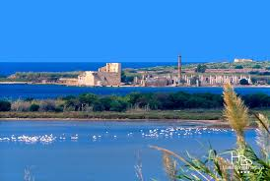
VINDICARI RESERVE
Siracusa
Notes:
18th century tuna processing plant
Vendicari Natural Reserve comprises is a mixture of lagoons, sand dunes, rocky coastlines, and sandy beaches. It was instituted in 1984 and is home to a wide variety of flora and fauna. The high salinity of the ground provides an ideal habitat for juniper bushes.
Thousands of migrating birds pass a few days here on their way to or from Africa. Flamingos, herons, storks and cormorants are regulars during autumn, while in the winter, ducks, mallards, pintails and terns take over. An ornithologists' paradise,.

Slide 18
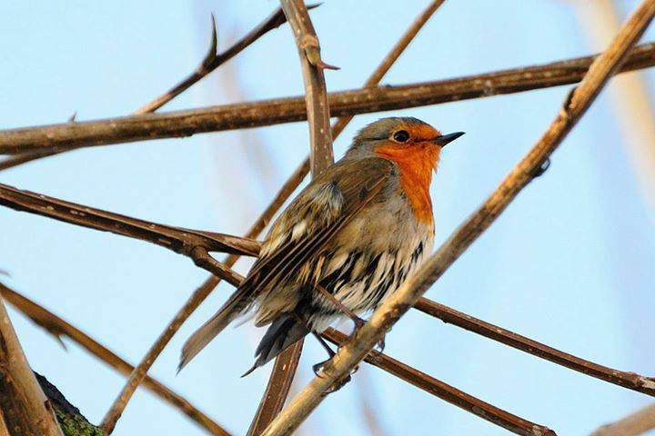
PETTIROSSO
Vindicari
Notes:
Makes its nest in thorny bushes

Slide 19
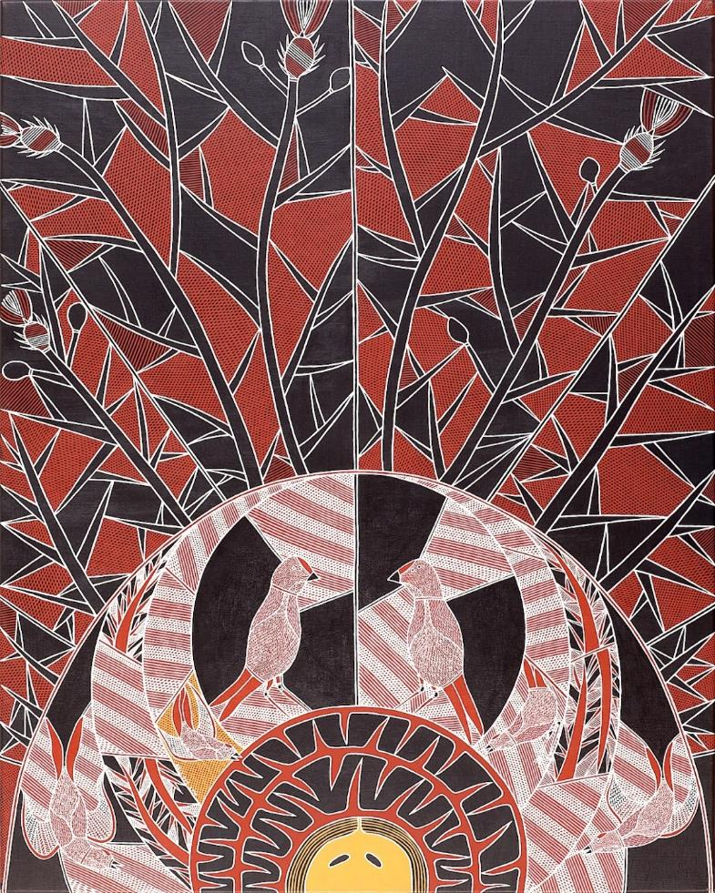
Pettirosso
Dreaming

Slide 20
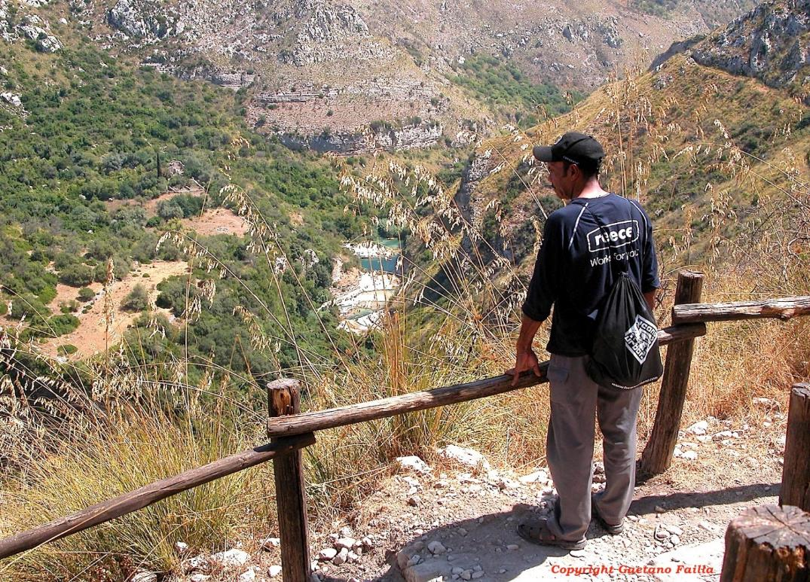
CAVA GRANDE DEL CASSIBILE Hyblean Mountains

Slide 21
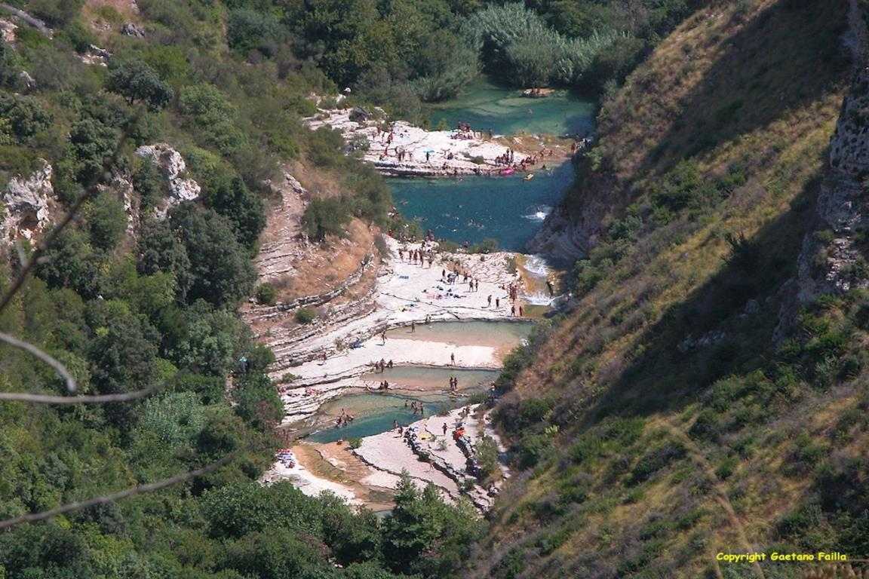
CAVA GRANDE DEL CASSIBILE
Hyblean Mountains

Slide 22
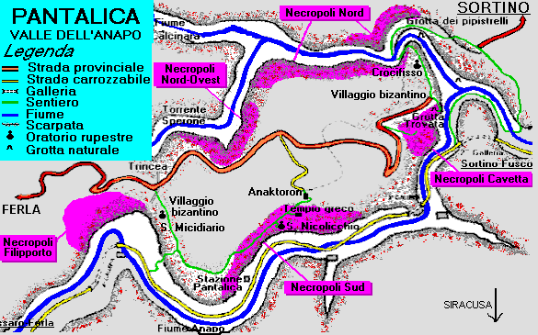
NECROPOLIS OF PANTALICA
Hyblean Mountains

Slide 23
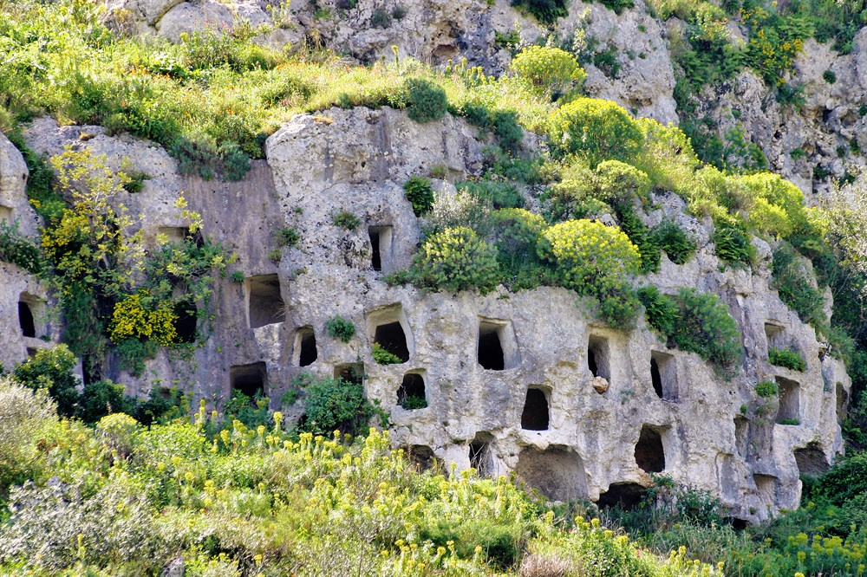
NECROPOLI OF PANTALICA
Hyblean Mountains
Notes:
Limestone rocks – Karsick

Slide 24
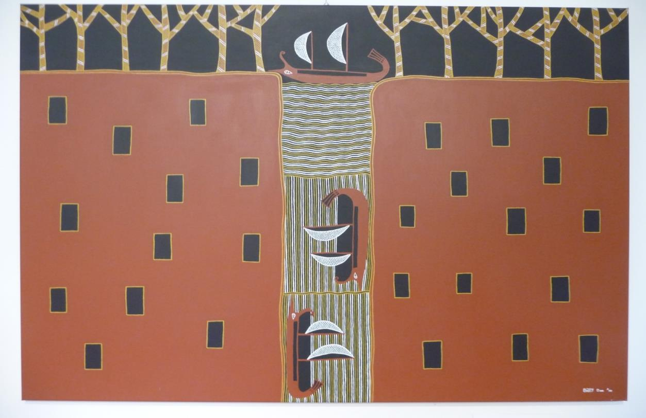
Pantalica Dreaming

Slide 25
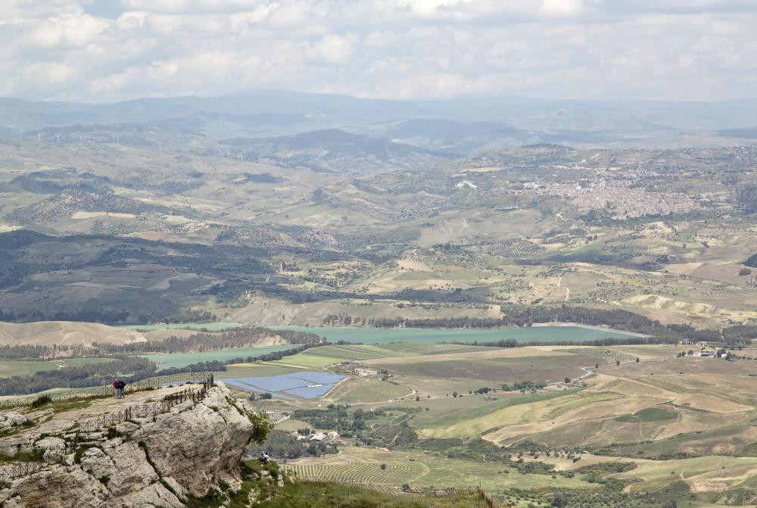
LAKE OF PERGUSA
Enna
Notes:
Demeter, otherwise known as Ceres, was the sister of Zeus. She had a daughter, Persephone, or Proserpine to the Romans. Pluto, god of the underworld lusted after Persephone. His brooding obsession compelled him to adbuct her and take her his realm. Demeter searched in vain for her lost daughter, eventually abandoning herself to disillusion and pain. Her reproach to the cruel world was to withhold the bounties of the harvest. Assisted by the nymph Arethusa, Demeter discovered the whereabouts of her daughter and pleaded with Zeus for her safe return. Persephone’s release was on the condition that she had refrained from eating. Sadly, she had already consumed the pulp of a pomegranate seed. This led to a good old-fashioned compromise: she would spend half the year in the sunlit uplands and half in the kingdom of Hades, during which time the still peeved Demeter would continue to withhold the fruits of the soil.

Slide 26
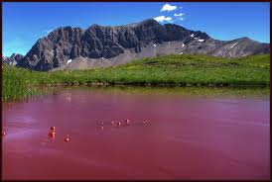
LAKE OF PERGUSA
Enna
Notes:
Lake Pergusa Special Nature Reserve is located a few kilometer from the city of Enna. The centre is at about 670 metres above sea level. The waters is brackish, although there is no link with the sea.
Lake Pergusa is the only true natural lake in central Sicily. Because of its geographical position, it is a humid oasis in a landscape that for long months is dominated by drought, and vital place for many species of birds.
Its in fact a perfect spot for birdwatchers in Sicily, but there are also mammals like the hedgehog and the weasel, reptiles like the fine marsh turtles and the strange congylus.
Lake Pergusa is known worldwide for a truly unique phenomenon: its blood red water which is created by the microscopical organisms which inhabit the lake, and in order to defend itself against the rays of the summer sun, takes on a red pigment and settles in very big colonies under aquatic plants. This pigment is then transferred to the water and to the bacteria that live in it, until the lake is transformed into "red water".

Slide 27
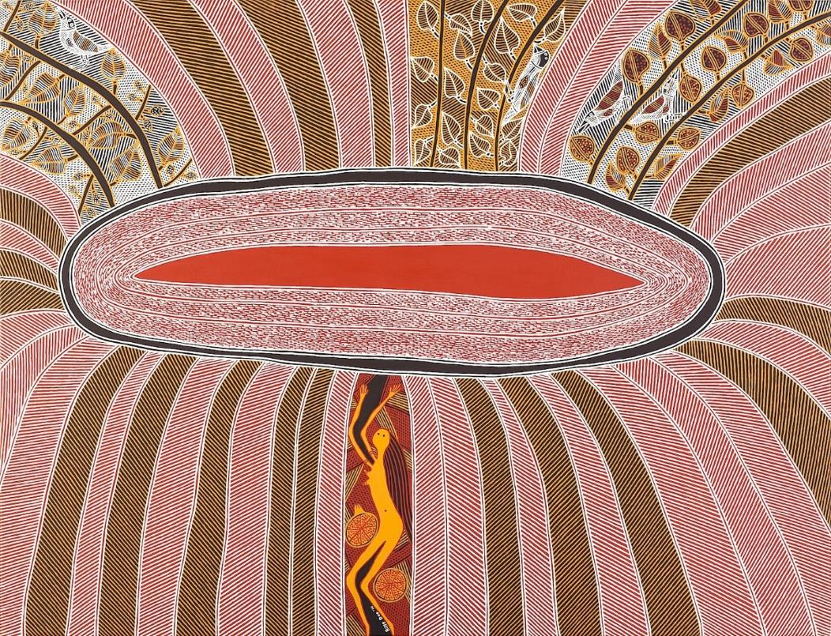
Pergusa Dreaming

Slide 28
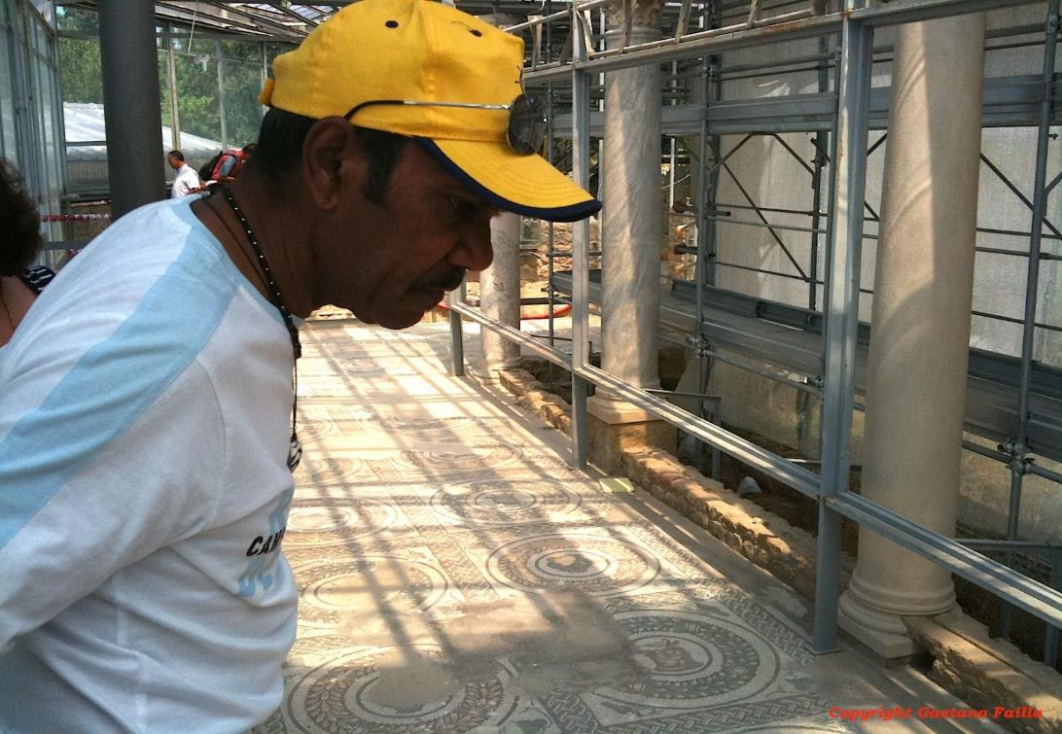
VILLA ROMANA DEL CASALE
Piazza Armerina

Slide 29
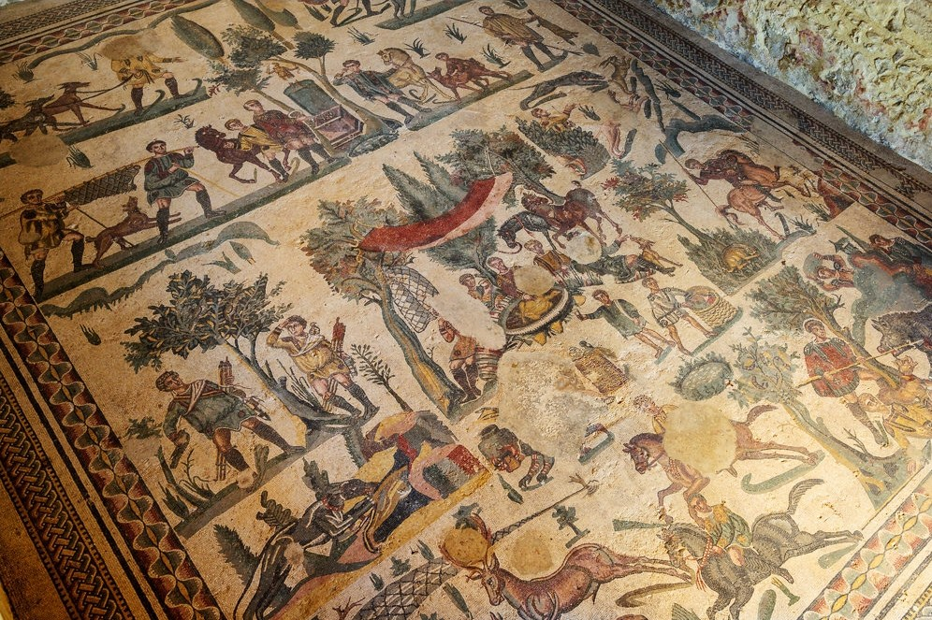
VILLA ROMANA DEL CASALE
Piazza Armerina

Slide 30
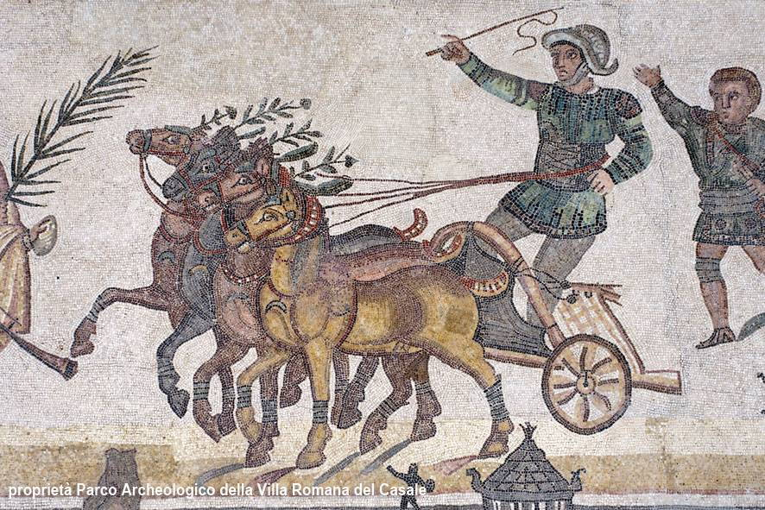
VILLA ROMANA DEL CASALE
Piazza Armerina

Slide 31
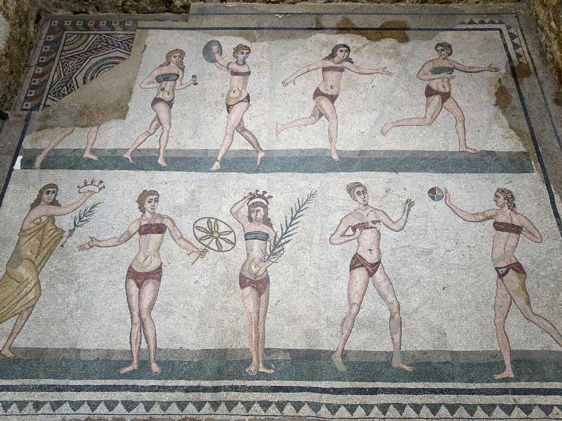
VILLA ROMANA DEL CASALE
Piazza Armerina

Slide 32
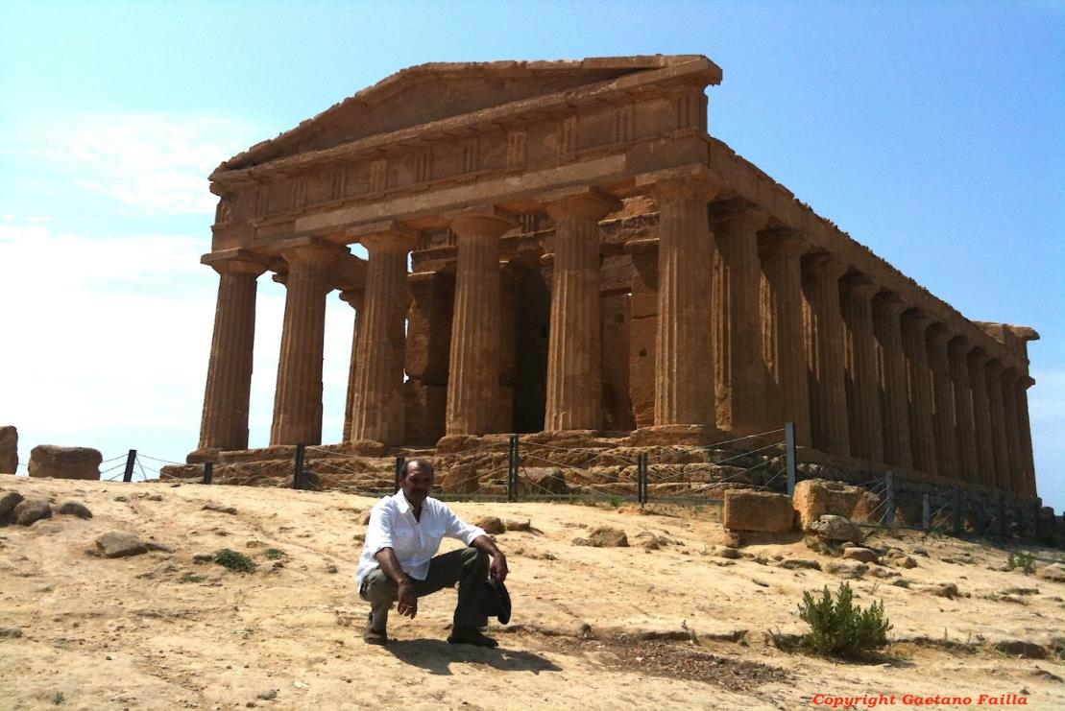
VALLEY OF THE TEMPLES
Agrigento

Slide 33
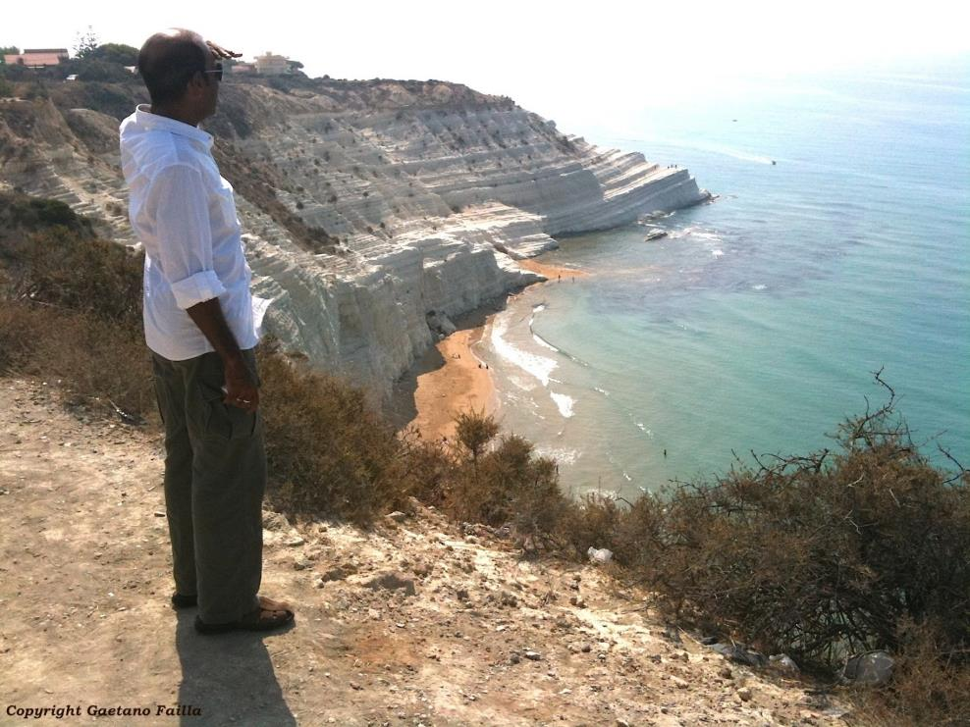
SCALA DEI TURCHI
Agrigento

Slide 34
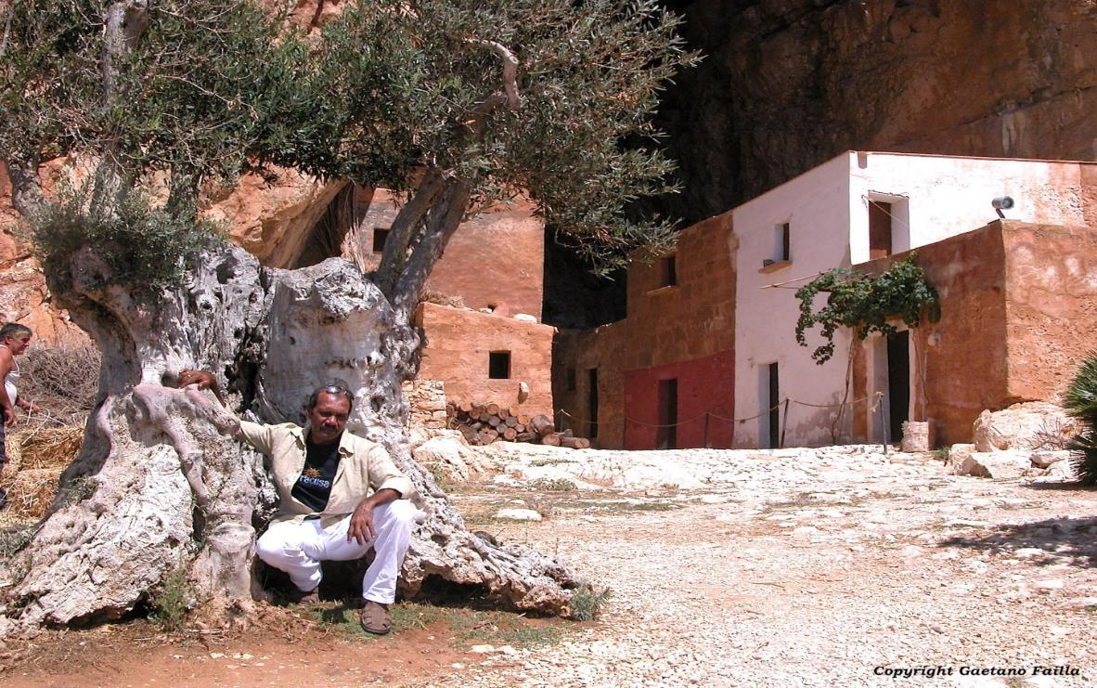
SCURATI CAVE
Mt Cofano - Trapani

Slide 35
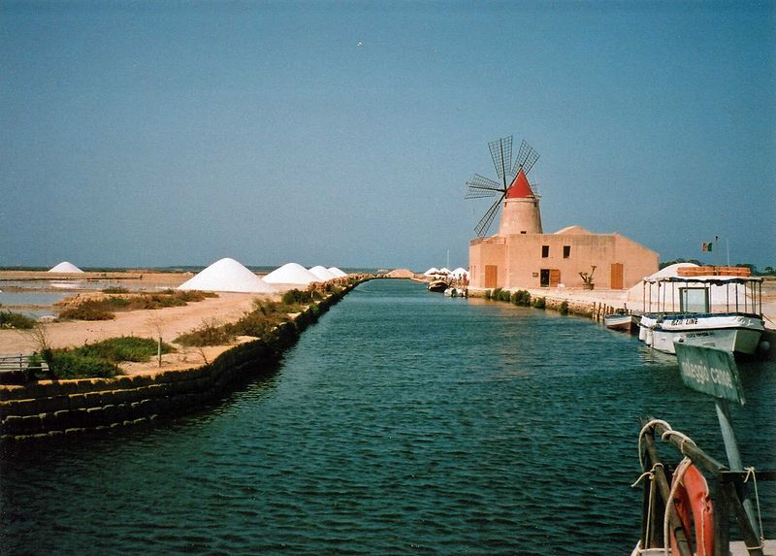
LAGOON OF SAN PANTALEO
Marsala

Slide 36
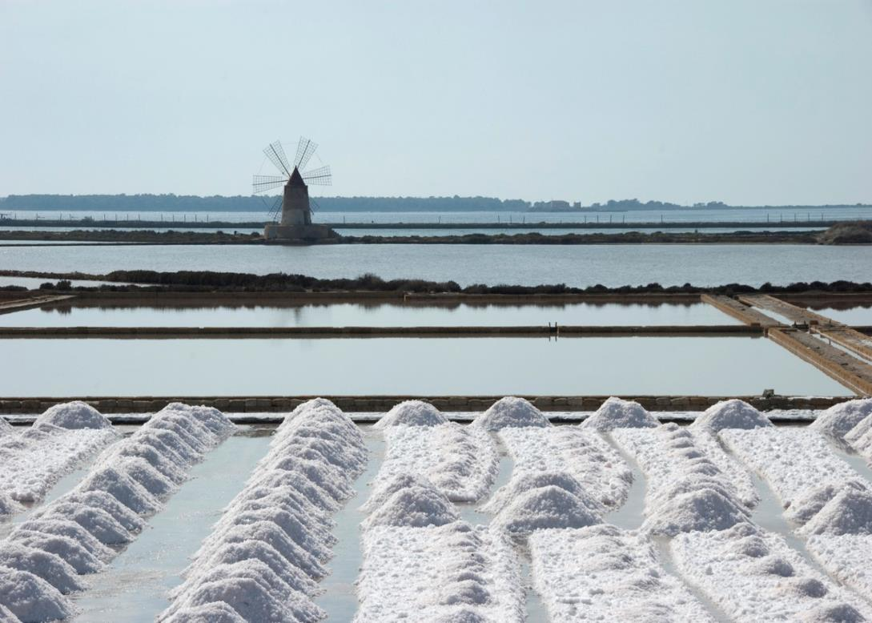
LAGOON OF SAN PANTALEO
Marsala

Slide 37
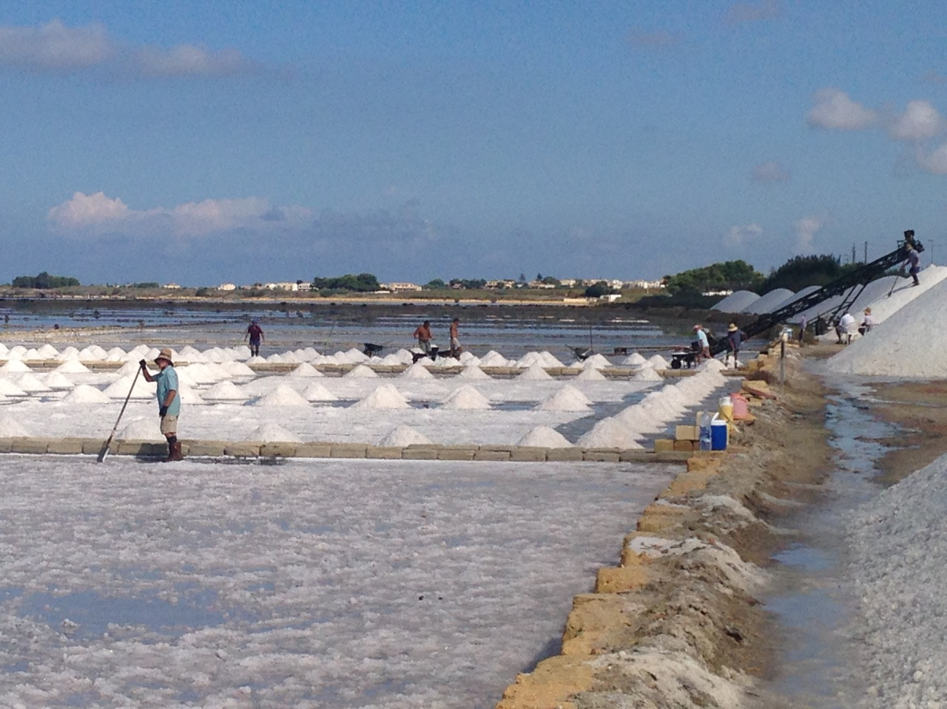
SALT PANS OF MOZIA
San Pantaleo Lagoon - Marsala

Slide 38
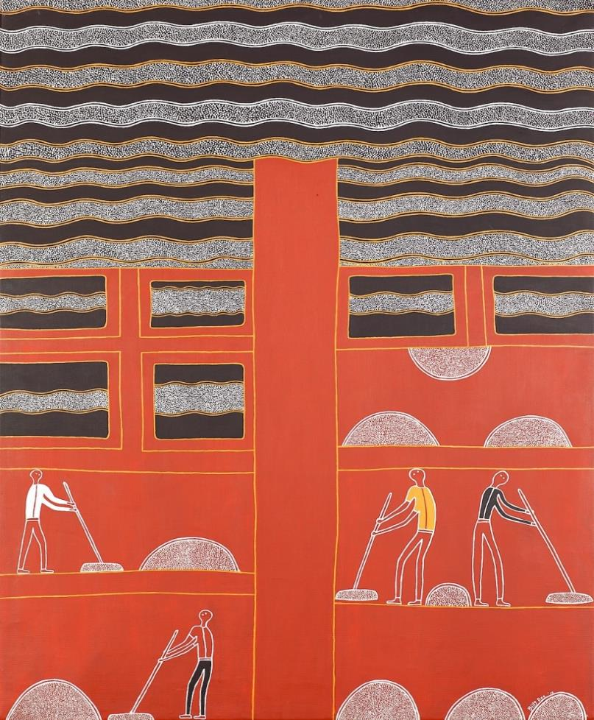
Salt Pans of
Mozia
Dreaming

Slide 39
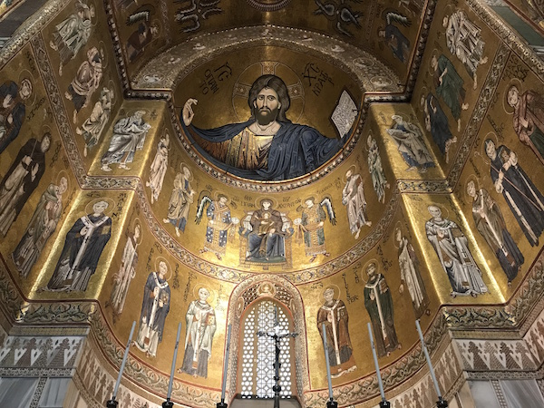
MONREALE CATHEDRAL
Notes:
The cathedral was built by William II after the English archbishop of Palermo sought, with the solid backing of the Pope, to assert his authority over the king by refusing to honor his father's wishes to be buried at Cefalù, instead interring him at Palermo Cathedral. William II immediately set about building a bigger and more artistically inspired cathedral, appointing his own archbishop, and making his cathedral the royal pantheon. The results survive today almost exactly as built in the 1100s.
The interior is impressive in its spaciousness and rich decor. Not only are there mosaics throughout, but also large antique columns with decorative capitals, marble paneling on the lower wall surfaces, and an ornamental floor in the sanctuary. The mosaics cover the upper portions of the walls of the sanctuary and the nave, in all a surface area of roughly 7.600 sq m. The Monreale Cathedral thus presents the most extensive mosaic decor in Italy, surpassing even Venice's San Marco.

Slide 40
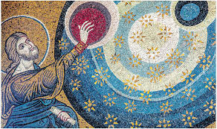
MONREALE CATHEDRAL

Slide 41
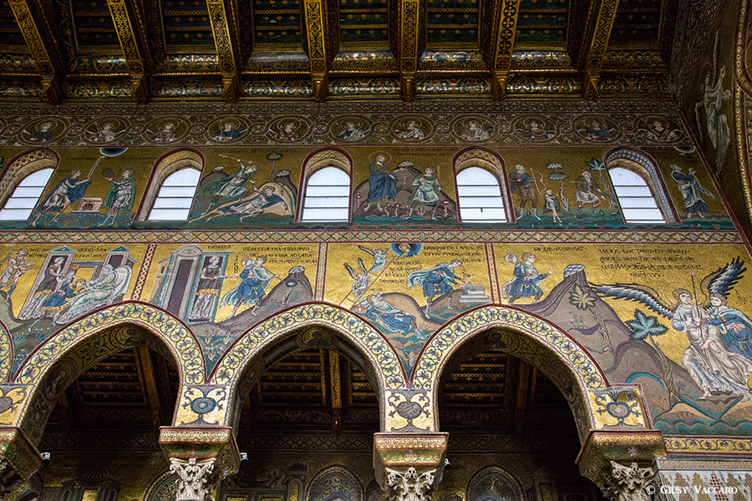
MONREALE CATHEDRAL

Slide 42
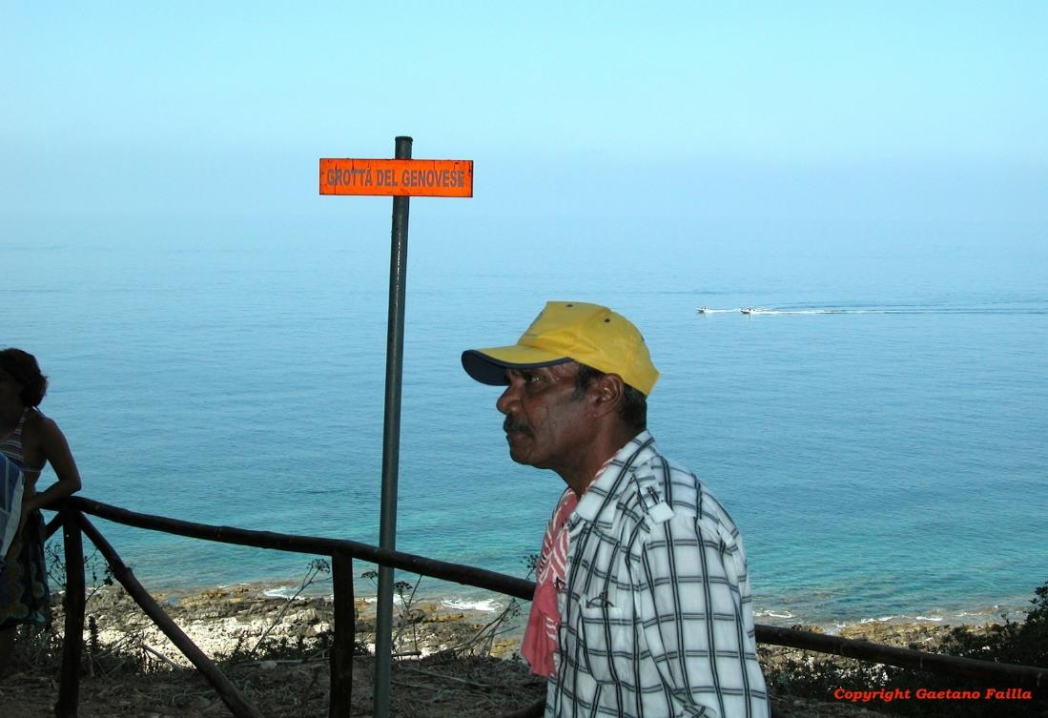
GROTTA DEL GENOVESE
Levanzo – Egadi Archipelago
Notes:
Between 6000 and 10,000 years old, the Upper Palaeolithic wall paintings and neolithic incised drawings at the Genovese Cave were discovered in 1949 by Francesca Minellono, a painter from Florence who was holidaying on Levanzo. Mostly featuring animals, the later ones also include men and tuna.

Slide 43
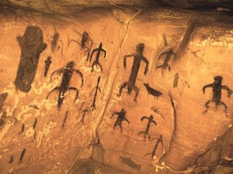
GROTTA DEL GENOVESE
Levanzo – Egadi Archipelago

Slide 44
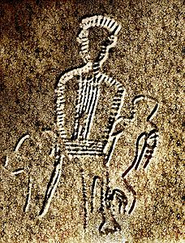
GROTTA DEL GENOVESE
Levanzo
Egadi Archipelago

Slide 45
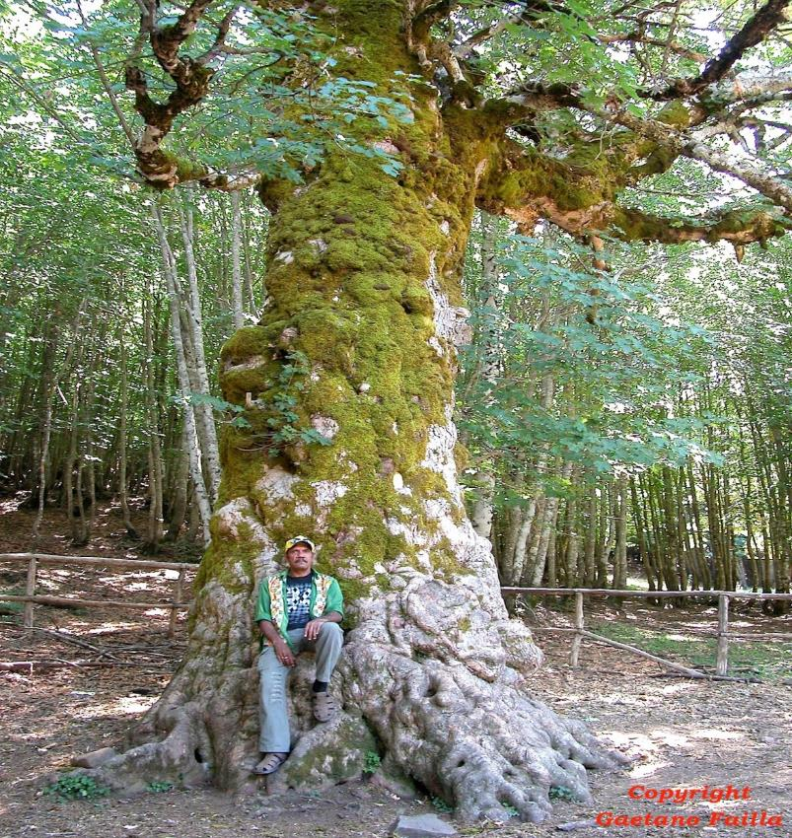
NEBRODI MOUNTAINS
Notes:
Nebrodi is Sicily’s largest nationalpark

Slide 46
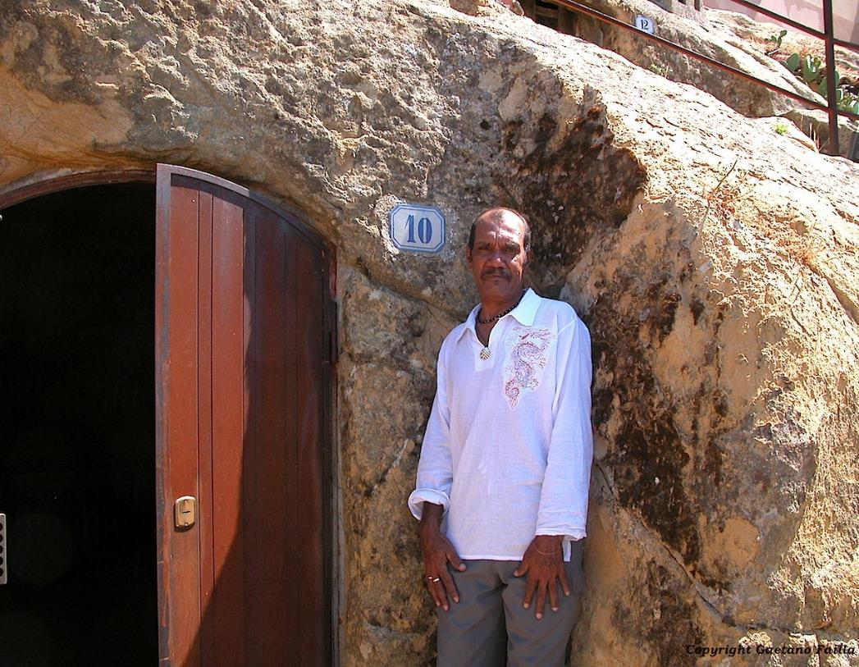
Sperlinga
Enna

Slide 47
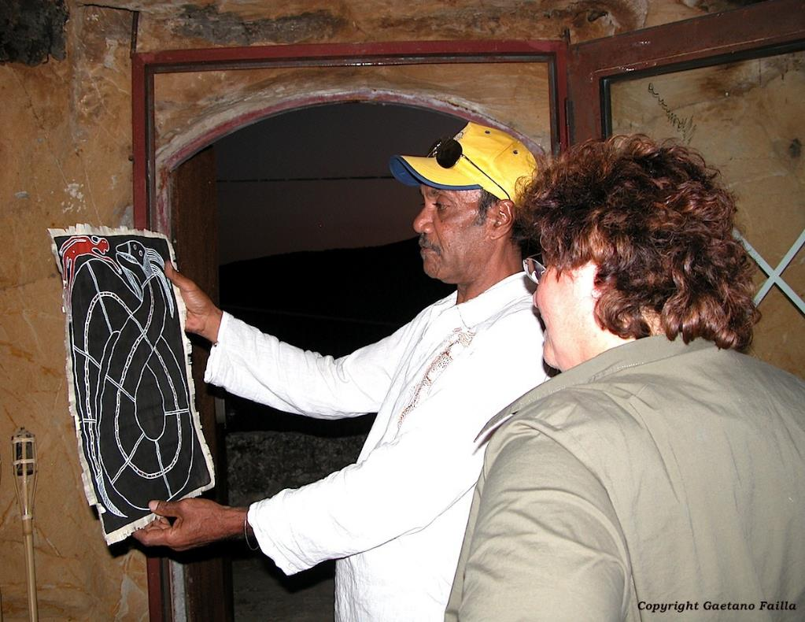
Sperlinga
Enna

Slide 48
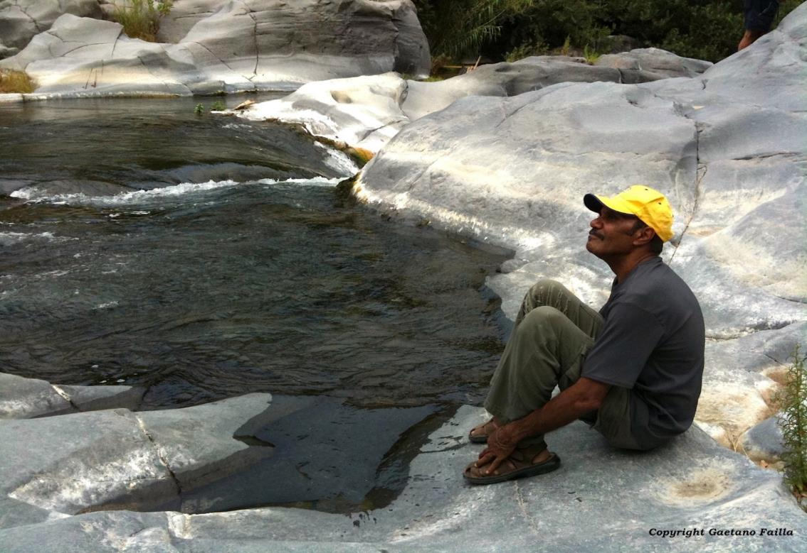
ALCANTARA RIVER

Slide 49
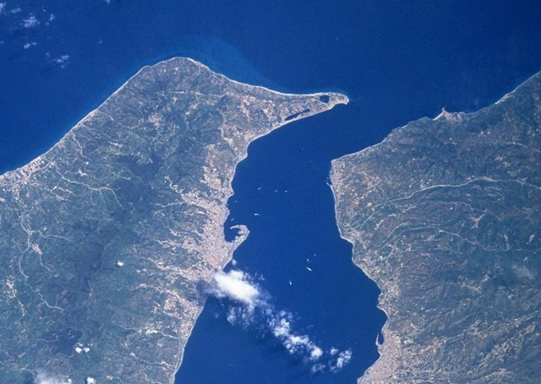
STRAIT OF MESSINA

Slide 50
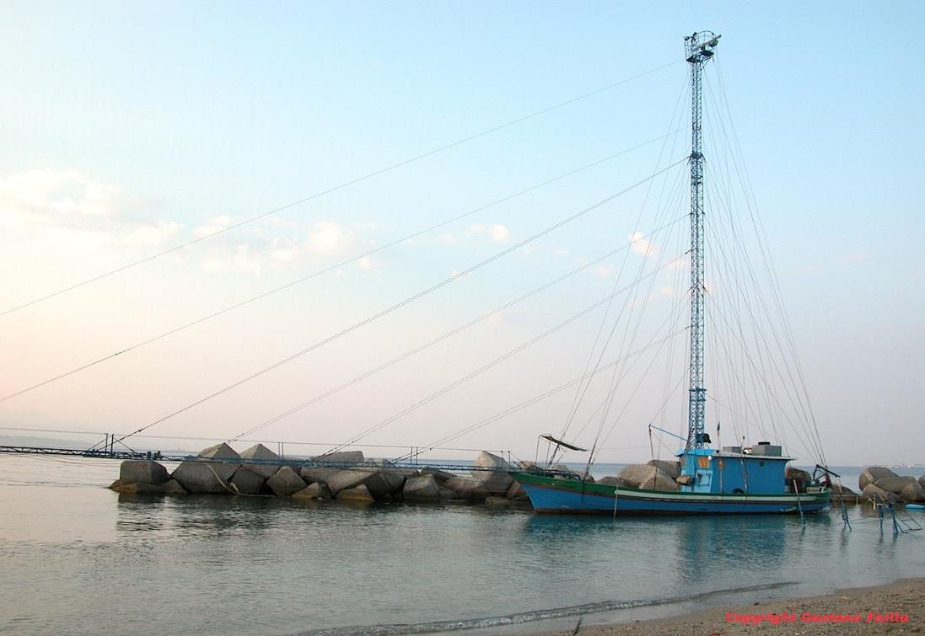
SWORD FISH HUNT
Strait of Messina

Slide 51
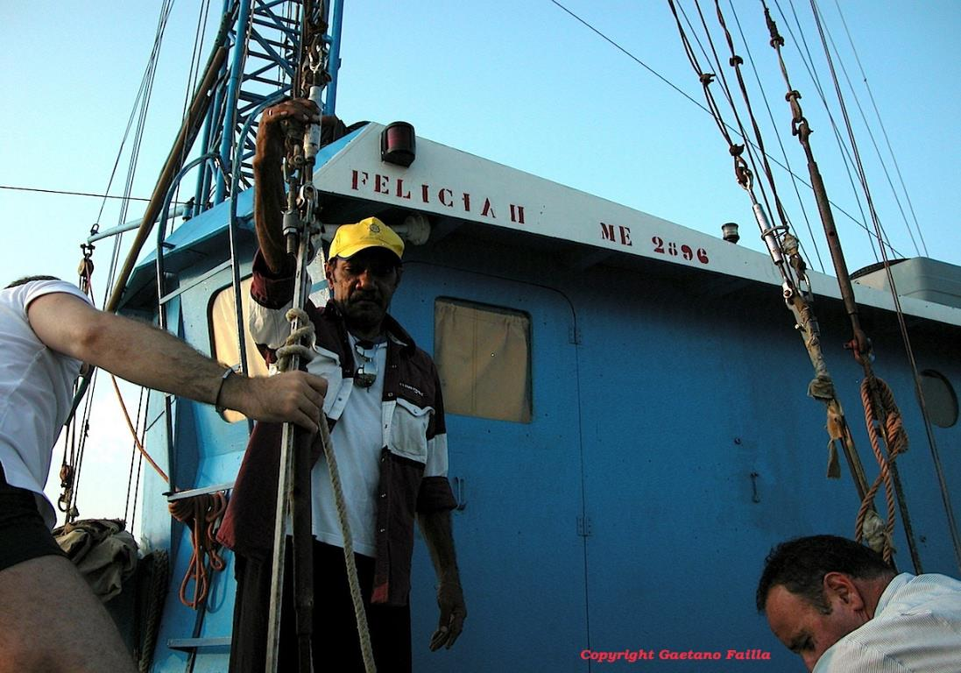
SWORD FISH HUNT
Strait of Messina

Slide 52

SWORD FISH HUNT
Strait of Messina

Slide 53

SWORD FISH HUNT
Strait of Messina

Slide 54

Sword Fish Dreaming

Slide 55
EXHIBITIONS
IN SICILY

Slide 56

GALLERIES

Slide 57

Siracusa
Monastero del Ritiro
Notes:
Peter Rayner – Charge’ D’Affairs – Australian Embassy in Rome
Mariella Muti – Assessore alla Cultura
Roberto Visentin – Major of Siracusa

Slide 58

Siracusa
Monastero del Ritiro
Notes:
Peter Rayner – Charge’ D’Affairs – Australian Embassy in Rome
Mariella Muti – Assessore alla Cultura
Roberto Visentin – Major of Siracusa

Slide 59

Enna
Centro Arte Contemporanea Bannata
Notes:
Exhibition innaugurated by Dott. Giuseppe Monaco – President Province of Enna

Slide 60

Enna
Centro Arte Contemporanea Bannata

Slide 61

Zafferana Etnea
Sala Consigliare – Comune di Zafferana

Slide 62

Zafferana Etnea
Sala Consigliare – Comune di Zafferana

Slide 63

Parco dell’Etna

Slide 64

Palermo
Villa Whitaker

Slide 65

Palermo
Villa Whitaker

Slide 66

Thank You

